Slide 1


Pressure Monitoring System
Emad Hajaj
Learn in Depth

Slide 2

Development of a Pressure Monitoring System for Airplane Cabinets
The aim is to design and implement a pressure monitoring system for airplane cabinets to ensure the safety and comfort of passengers and crew during flight. The system will utilize advanced sensors to continuously monitor the pressure within the airplane cabinets and provide real-time data to the flight crew.
In the event of any deviations from the optimal pressure range, the system will trigger alerts and notifications to prompt appropriate corrective actions.

Slide 3

01
Case study

Slide 4

Client Requirements
The client has requested the development of a pressure controlling system for an aircraft cabin. The system is designed to alert the crew when the cabin pressure exceeds 20 bars, with the alarm lasting for 60 seconds. The system is expected to monitor the pressure values and trigger the alarm when necessary. This case study outlines the development process and considerations for the pressure controlling system.

Slide 5

The pressure sensor and the alarm never fails. The controller never faces power cut
The initial version of the pressure controlling system does not include the option to keep track of measured values
Assumptions and Limitations
The controller set up and shutdown procedures are not modeled
The controller maintenance is not modeled

Slide 6

02
Method

Slide 7
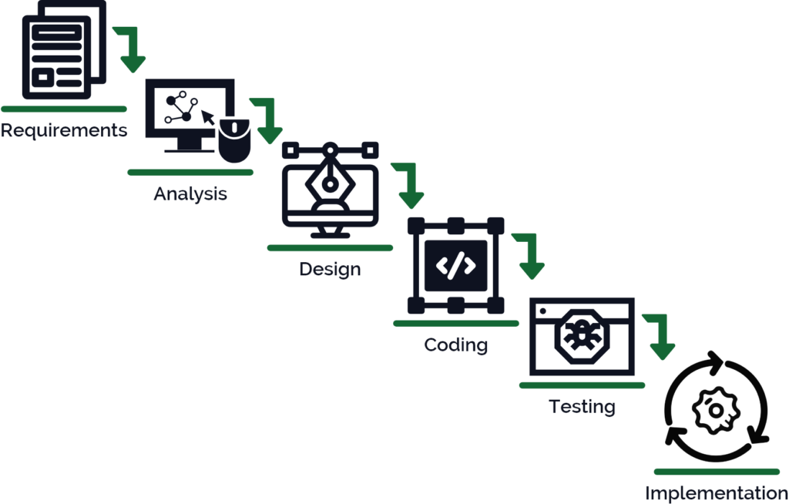
waterfall model
In the implementation of this project, I am going to follow the waterfall model method

Slide 8

03
Requirements

Slide 9
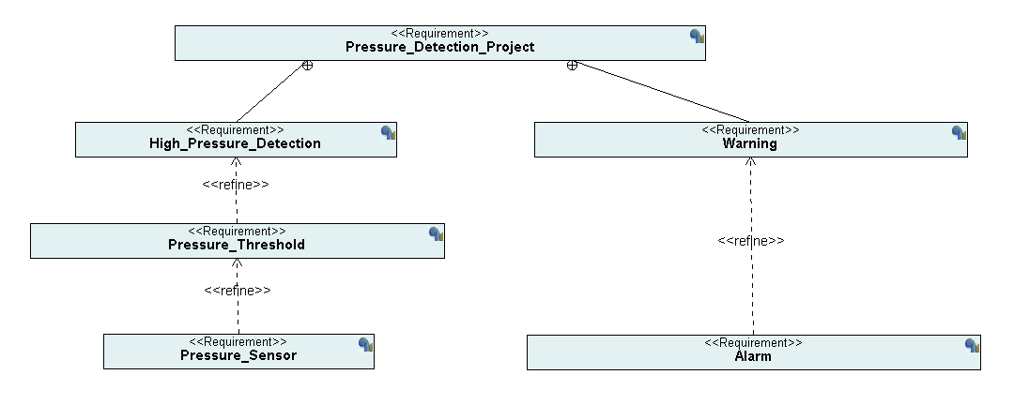
To implement this system, we are going to divide it into two main sub systems which are:
- Measurement system: and that includes the pressure sensor and comparing it to the threshold given by customer
- Warning system: and that includes the alarm and monitoring it
System
Requirements

Slide 10
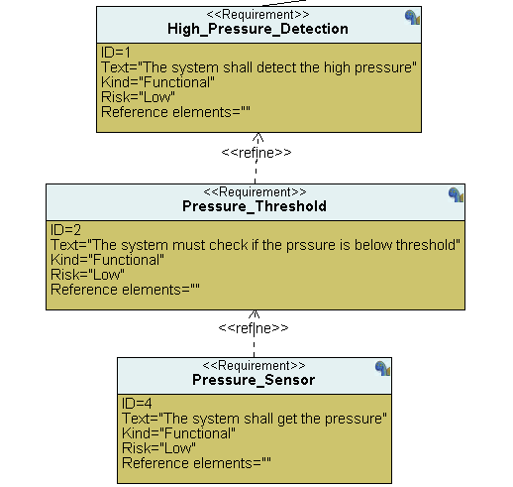
Measurement system
This system’s main function is to get the Readings from the pressure sensor and continuously compare it to the threshold value in the real-time to be able to act immediately.

Slide 11
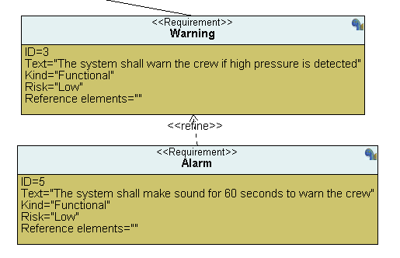
Warning system
This system’s main function is to turn the alarm on and keep it on for a period then turn it off if the cause is no longer exists

Slide 12
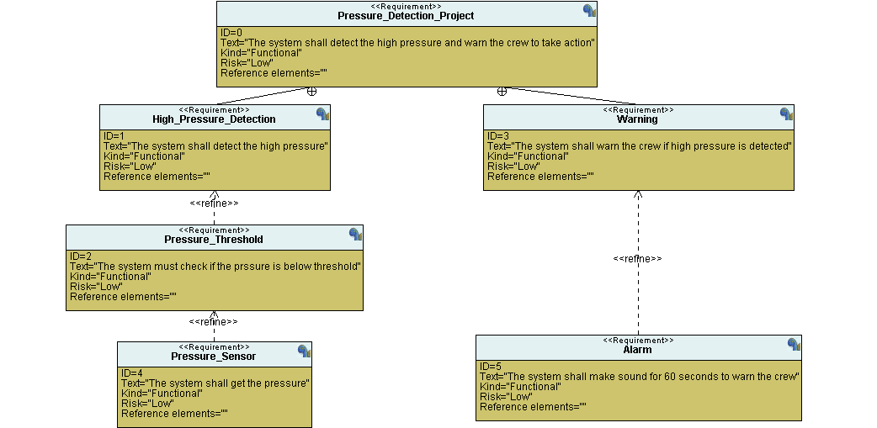
System
Requirements

Slide 13

04
Space Exploration

Slide 14

Because our system is time critical and to keep the cost low while still having a decent performance, we chose to use STM32F103C6 microcontroller to deliver that.

Slide 15

05
System analysis

Slide 16
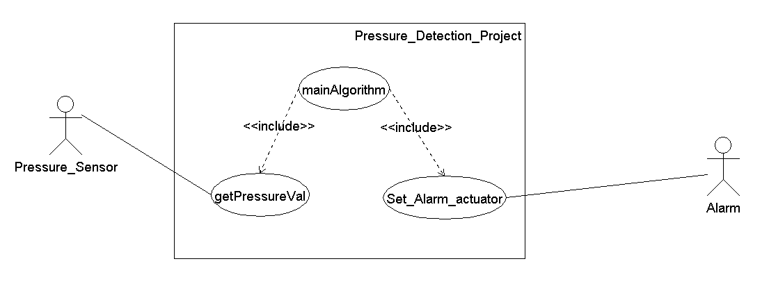
Use case diagram
The system will include 3 main functions which are getPressureVal which will be in the sensors driver, and it will be called in the mainAlgorithm which is responsible for taking the action based on the threshold and pressure value, the action will be calling Set_Alarm_actuator which will be in the alarm driver, and it is responsible for turning it on and monitoring it.

Slide 17
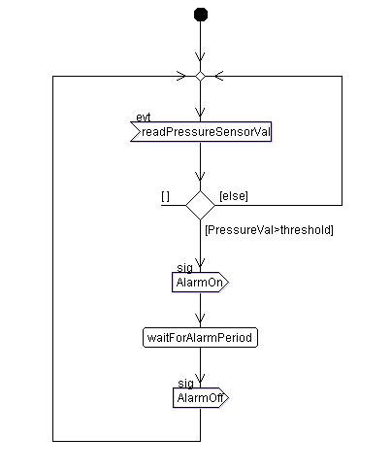
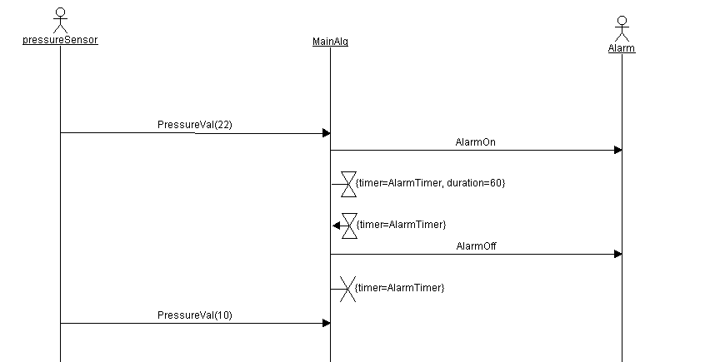
Possible Scenario

Slide 18
06
System Design

Slide 19
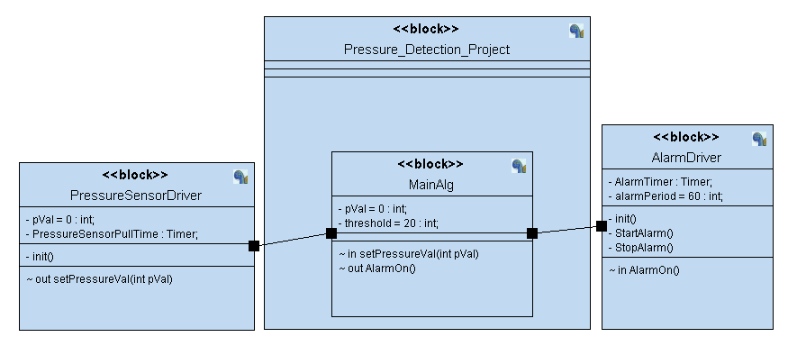
The block diagram
This block diagram shows the files included in the project and how they interact with each other

Slide 20
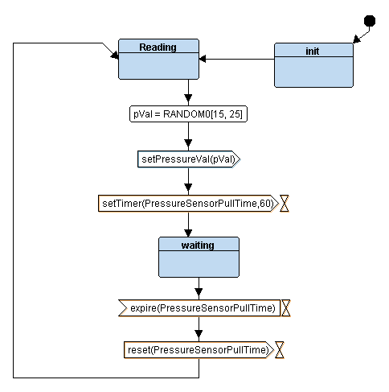
Pressure Sensor Driver
This is the states of the pressure sensor where it initializes as soon as it gets power, then goes to reading state. At reading state, we get the pressure from setPressureVal function then send it to the main algorithm, then set a timer and get to waiting state. In waiting state, we wait a period until we get the next reading to avoid conflict. After the timer is off, we go back to reading state.

Slide 21
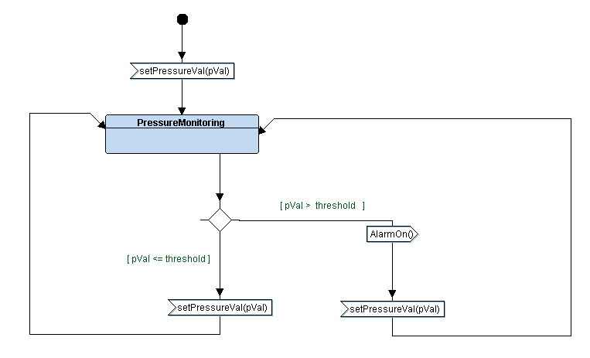
Main Algorithm
The main algorithm is the logic used in implementing the project, as it is continuously comparing the value of the pressure it gets from the pressure sensor to the threshold, if it exceeds it turns the alarm on

Slide 22
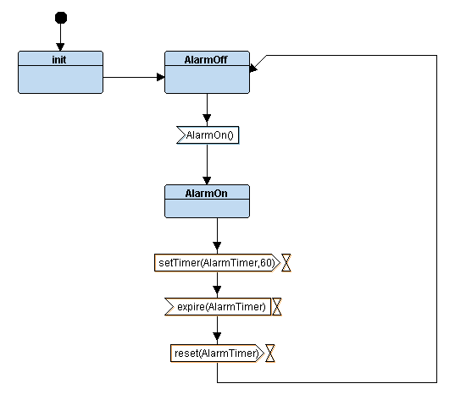
Alarm Driver
This is the states of the alarm where it initializes as soon as it gets power, then goes to AlarmOff state. When it gets AlarmOn signal from the main algorithm it goes to AlarmOn state and stays on for 60 (period chosen by the client), then goes back to AlarmOff state.

Slide 23
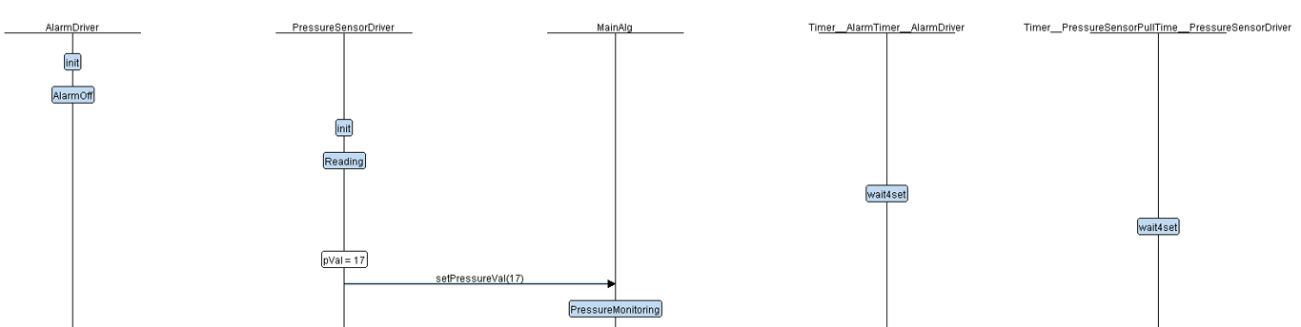
System Simulation
At the beginning the alarm initializes and the pressure sensor initializes, then start reading pressure values and sending it to the main algorithm

Slide 24
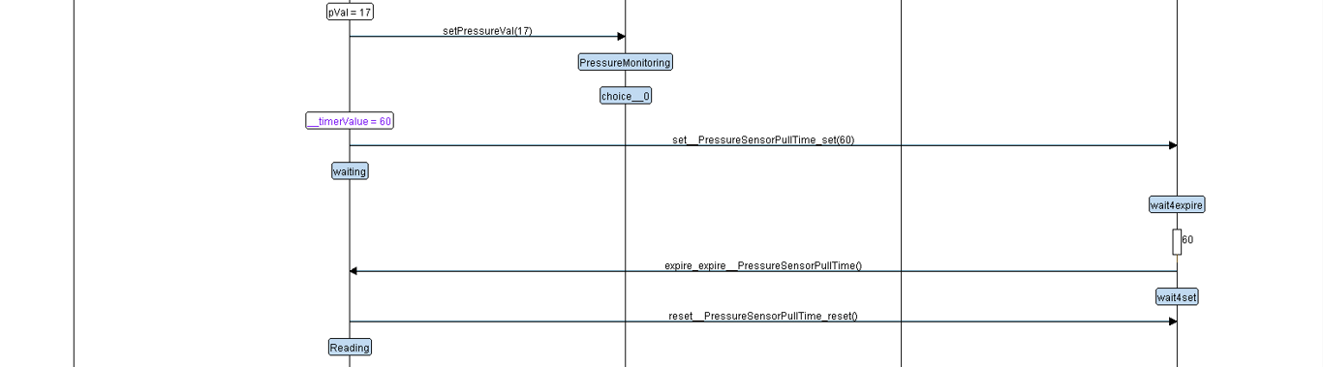
Reading
Main Alg
Below threshold
After reading the value of the pressure it is sent to the main algorithm, then it is compared to the threshold
When the value is below threshold it keeps the alarm off and reads the pressure again

Slide 25
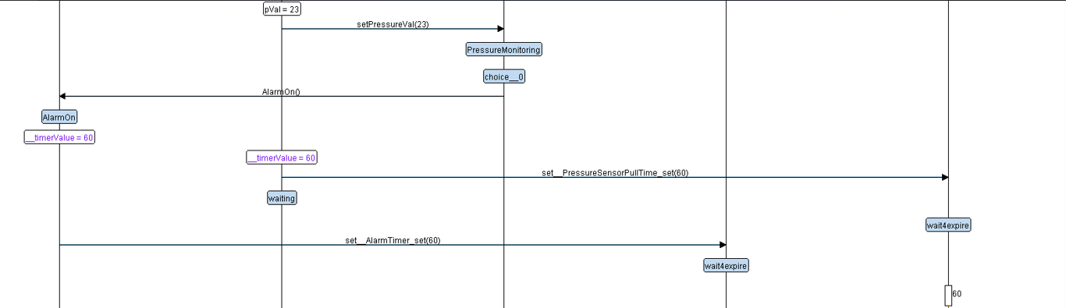
Above threshold
Reading
Main Alg
We get the value again and send it to the main algorithm to compare it to the threshold
When it is above the threshold it turns the Alarm on and start the timer of the alarm and the timer of sensor

Slide 26
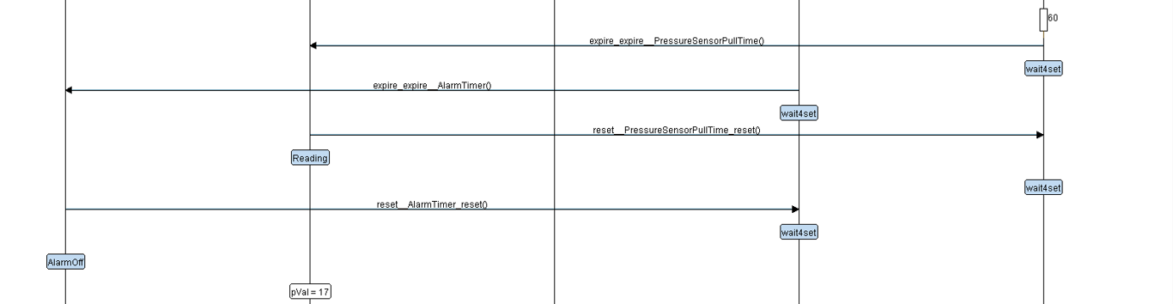
Above threshold
Alarm on
Main Alg
The alarm is on as soon as it gets the signal from the main algorithm and until the timer is off
The main algorithm goes back to reading the values after the timer of the sensor is off

Slide 27

THANKS
GitHub
emadhajaj/Mastering-Embedded-Systems (github.com)

